Slide 1

AUTONOMOUS VEHICLE PERCEPTION
DSA0205-Computer Vision with Open CV
Guided By
Dr. NARENTHIRA KUMAR A
Yaswanth
192324179

Slide 2
Abstract
Autonomous Vehicle Perception is a core technology that enables self-driving vehicles to understand their surroundings and make safe driving decisions without human intervention. It uses multiple sensors, including Camera, LiDAR, Radar, GPS, and IMU, to collect information about roads, vehicles, pedestrians, traffic signs, and obstacles. The collected data is processed through stages such as image acquisition, preprocessing, perception, localization, planning, and vehicle control to accurately detect objects, determine the vehicle's position, and plan a safe path. Each sensor contributes unique information, making sensor fusion essential for improving accuracy and reliability. However, designing an effective perception system involves several trade-offs, including balancing sensor accuracy, processing speed, computational complexity, and cost to achieve real-time performance. An efficient perception system enhances safe navigation, collision avoidance, lane keeping, and traffic sign recognition, making autonomous vehicles more reliable and intelligent in real-world driving environments.

Slide 3
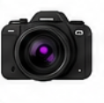

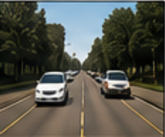
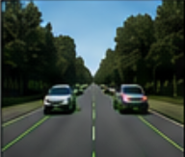
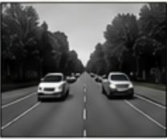
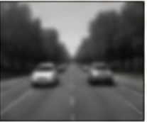
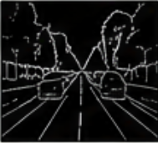
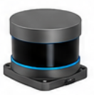


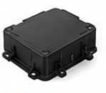






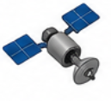



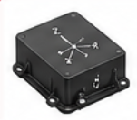
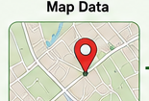
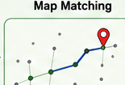
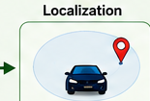






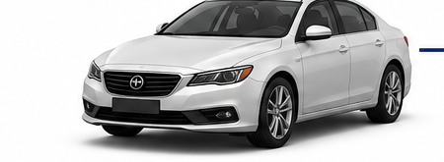
AUTONOMOUS VEHICLE PERCEPTION SYSTEM
INPUT SENSORS
PERCEPTION
PLANNING
Camera
1. IMAGE ACQUISITION & PREPROCESSING
Route Planning
(Images)
Input Image
Resize
Grayscale
Gaussian Blur
Edge Detection
Path Planning
LiDAR
(Point Cloud)
Obstacle Avoidance
2. PERCEPTION TASKS
Lane
Detection
Vehicle
Detection
Pedestrian
Detection
Traffic Sign
Detection
Traffic Light
Detection
Speed Planning
Radar
(Objects &
Velocity)
CONTROL
GPS
Steering
Controller
Speed
Controller
Brake
Controller
(Position)
LOCALIZATION
Map Data
Map Matching
Vehicle
Localization
IMU
Actuation Commands
(Steer, Accelerate, Brake)
Motion & Orientation
LEGEND
VEHICLE OUTPUT
Perception
Localization
Planning
Control
Lane
Keeping
Obstacle
Avoidance
Speed
Control
Traffic Sign &
Light Recognition
Safe
Navigation
Sensor Data Flow

